Slide 1
Sales Strategy
Analysis
Sourav Maity
10th Oct 2023

Slide 2







Business objectives
Decrease
Offline business mode
Increase
Revenue and overall profit
Increase
Penetration in low performing market
Increase
SEO of website for better online presence
Increase
Penetration inlow price product segment

Slide 3
Key Insights
137 M Total Revenue | 44 M Total Profit | 23 DAYS Average Delivery TAT | 50% Revenue from Africa and Europe
59% Offline Business Drop | 57% Online Business Decline | 513K Total Units Sold | 72% Revenue Generated From Top3 Products

Slide 4
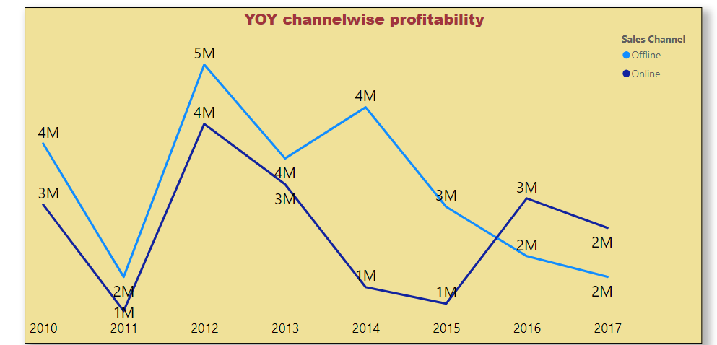
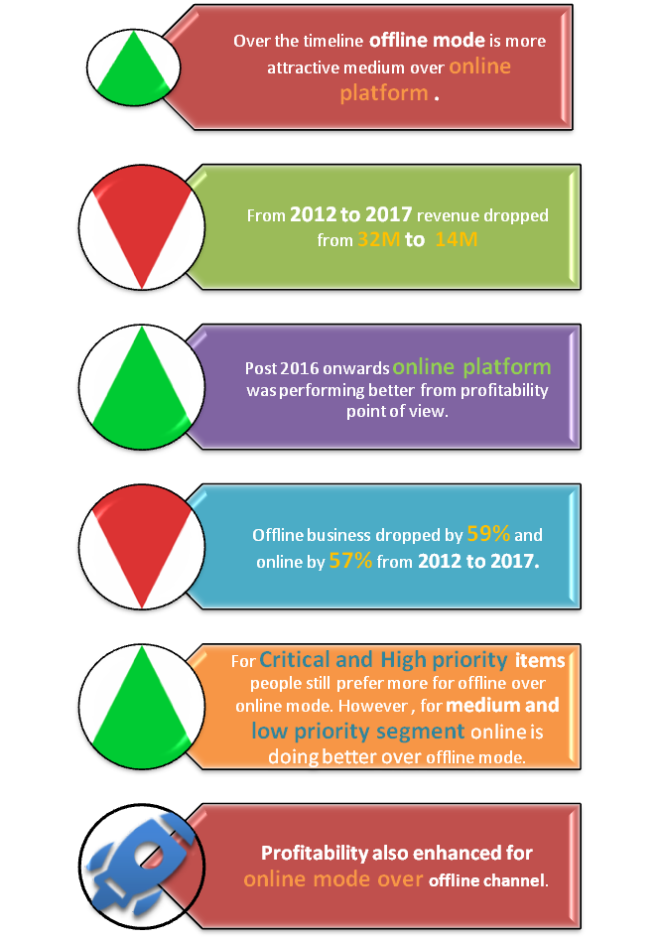
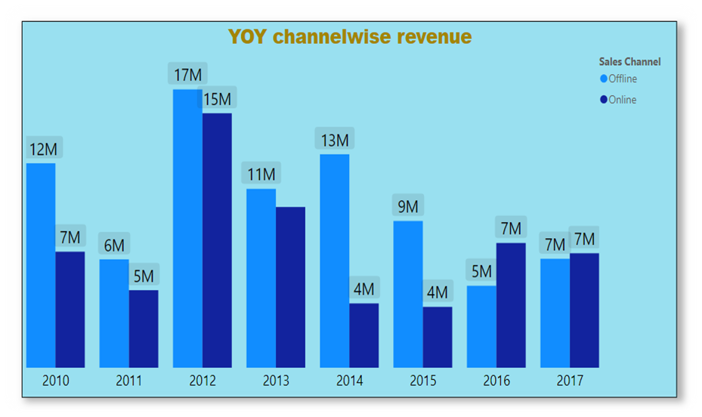
Channel Analysis
Over the timeline offline mode is more attractive medium over online platform . However 2016 onwards online doing better over offline mode.

Slide 5
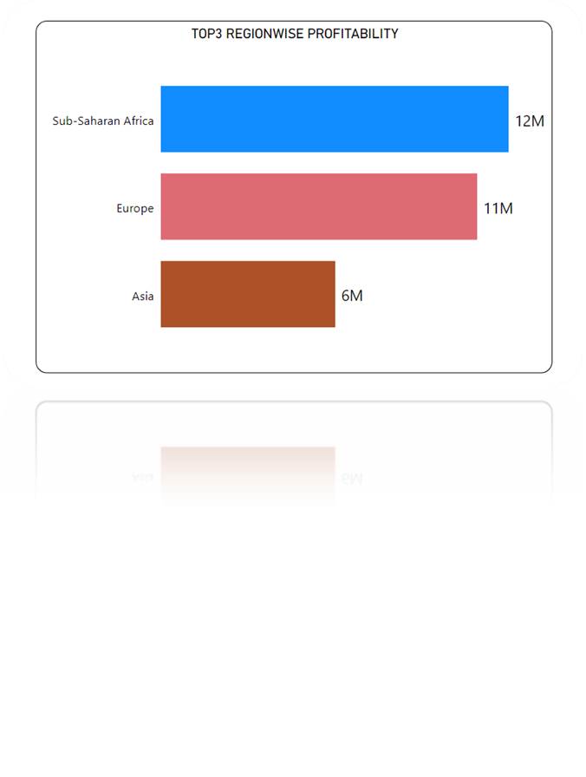
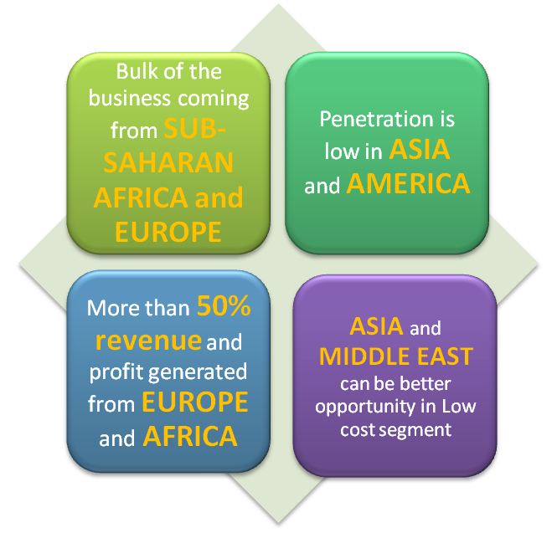

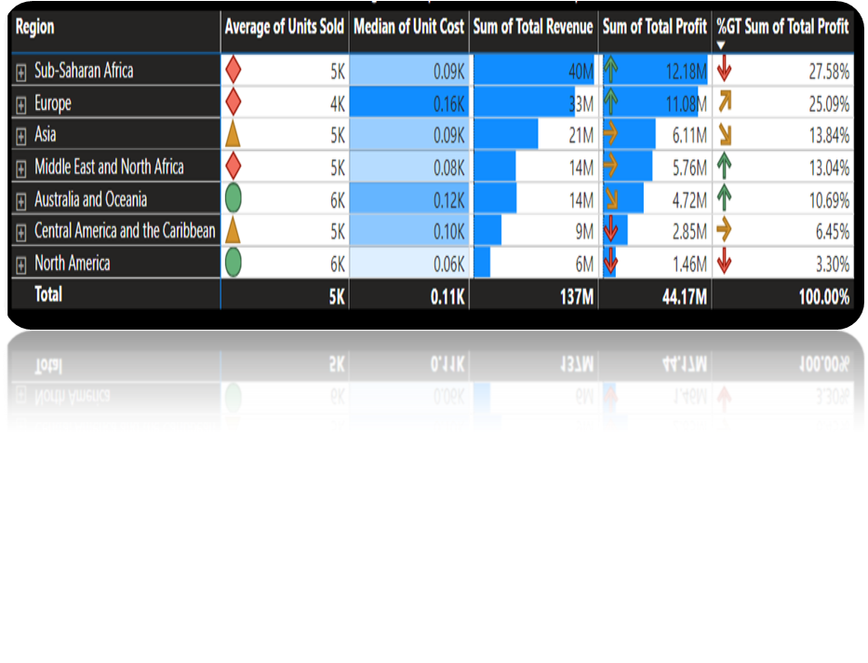
Geographical Analysis

Slide 6
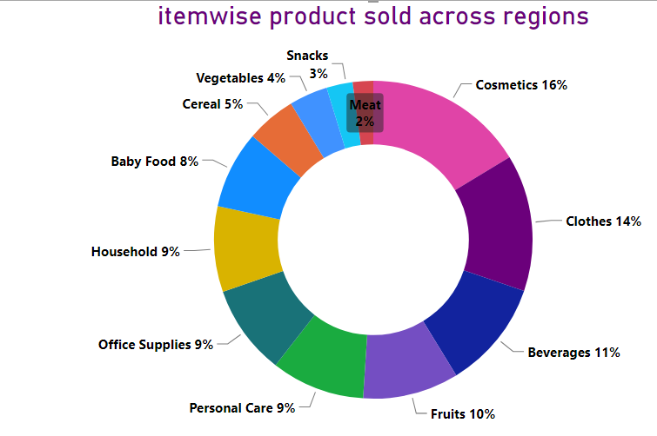
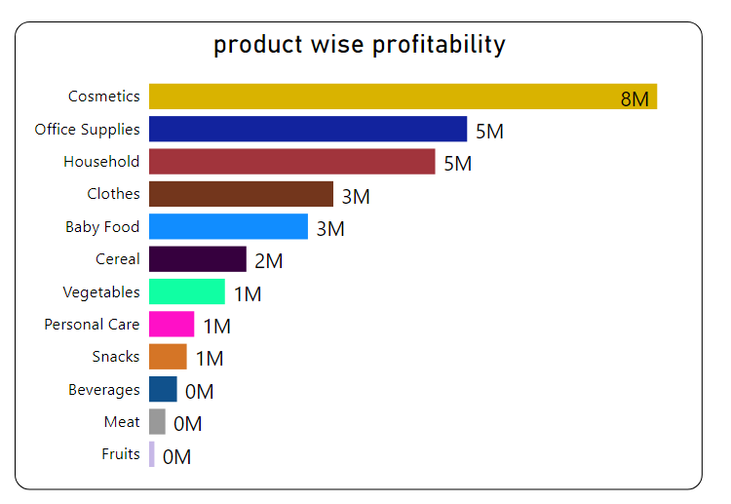

Product penetration
Cosmetics, cloths and Beverages are TOP 3 selling products . Ideally, these products can be categorized as medium and low priority segment.
Essentially daily critical and high priority segment like baby food, vegetable and meat it is not performing well except fruit.
In emerging market like Asia where population is at higher side can be good market at low median price segment. However, traditionally it has not done well across segments which can be key indicator for sharp decline in business penetration.
Even high TAT for offline mode can be the reason why people did not trust the channel for critical and high priority items.

Slide 7








Strategic Alignment Planning
Improve penetration Critical and High Sector
Customer retention to enhance revenue
Better penetration in Asia
Reduce delivery TAT
Asian Market
business in High and Critical product line
delivery TAT to be competitive
Enter into Indian and Chinese Market and improve market share
Improve TAT to attract more customer for offline business
Improvement in Shipping TAT can
business in low cost segment
offline business
Reduce Operational Cost
Improve business in low cost daily items
Online Mode
Marketing more on online platform to be competitive
Aling Offline market stores at strategic location to reduce cost and improve operational efficiency

Slide 8
Limitations
Demographical data was not available to analyze data across gender, income and various age group levels .
Customer churn data and online traffic conversion details were not available to measure the efficiency of online mode.
Due to too much of irregularity in time series data trend forecasting could not be exercised.
Limited data points

Slide 9
Thank You

Slide 10
References
https://explodingtopics.com/blog/countries-internet-users
https://explodingtopics.com/blog/countries-internet-users

